Slide 1

OGBA OKPANKU
21 FEBRUARY, 2026

Slide 2
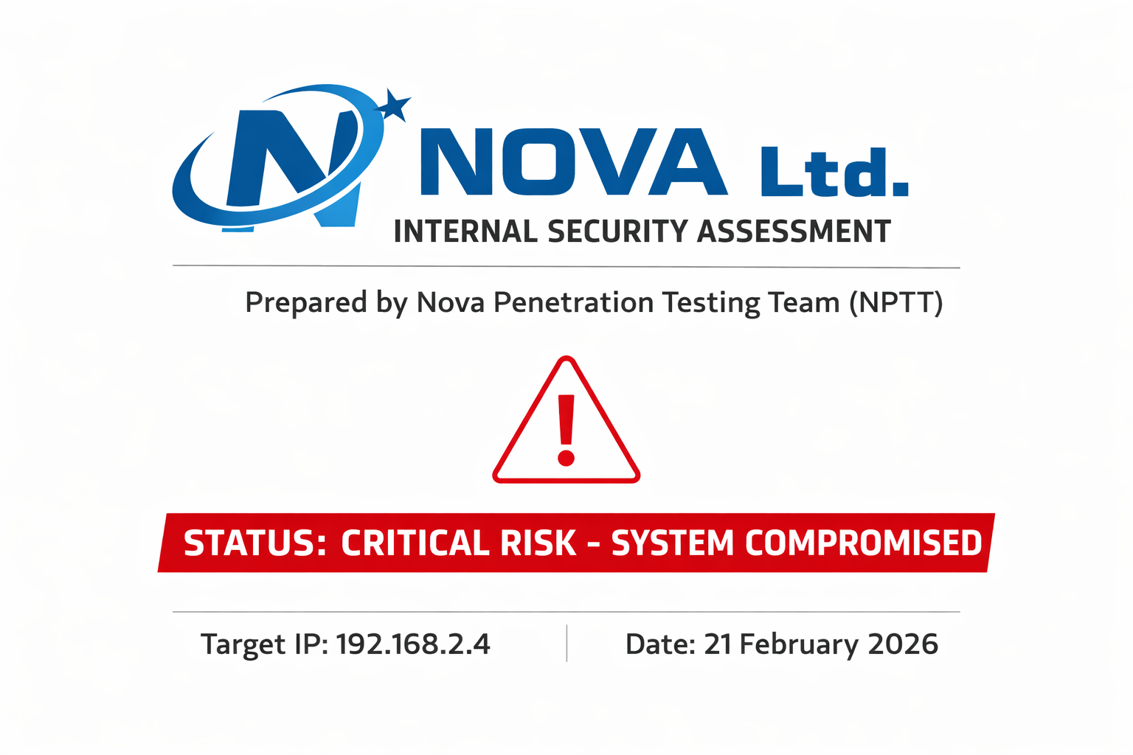

Slide 3
Executive Summary
A comprehensive Internal penetration testing was conducted against the target host 192.168.2.4 to evaluate the security posture of the system and identify vulnerabilities that could be exploited by an attacker. The assessment identified a catastrophic security posture, with multiple high-impact vulnerabilities that allow for immediate and unauthenticated Root-level compromise.
The system is currently running several "End-of-Life" (EOL) services dating back to 2007–2011, including a pre-installed Root Bindshell (Port 1524) and a Malicious Backdoor in the FTP service (Port 21). Furthermore, critical flaws in Java RMI, Telnet, and MySQL provide multiple redundant paths for an attacker to gain full administrative control, exfiltrate sensitive data, or disrupt operations.

Slide 4
Methodology
The penetration test followed a structured industry-standard frameworks such as OWASP and NIST penetration testing guidelines.
The assessment consisted of the following phases:
Reconnaissance
Service Enumeration
Vulnerability Identification
Exploitation
Post-Exploitation
Reporting
The objective was to simulate the techniques used by real-world attackers to identify security weaknesses. Testing was performed using tools including:
Nmap
Metasploit Framework

Slide 5
Scope of engagement
In-Scope
The penetration test was conducted within an isolated lab environment consisting of:
Attacker Machine: Kali Linux
Target Machine: Metasploitable 2
Network Type: Internal Virtual Network
Out of scope
The assessment did not include:
Denial-of-Service (DoS) attacks
Testing of systems outside the defined target IP address
Physical security testing
Social engineering attacks

Slide 6
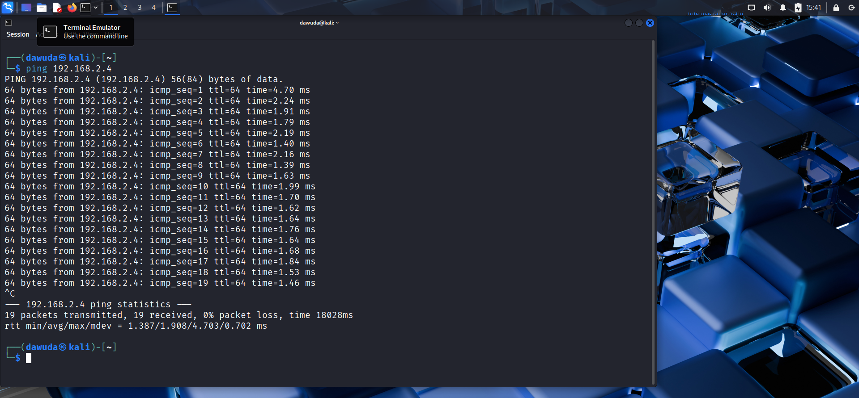
Ping the target ip on the host machine

Slide 7
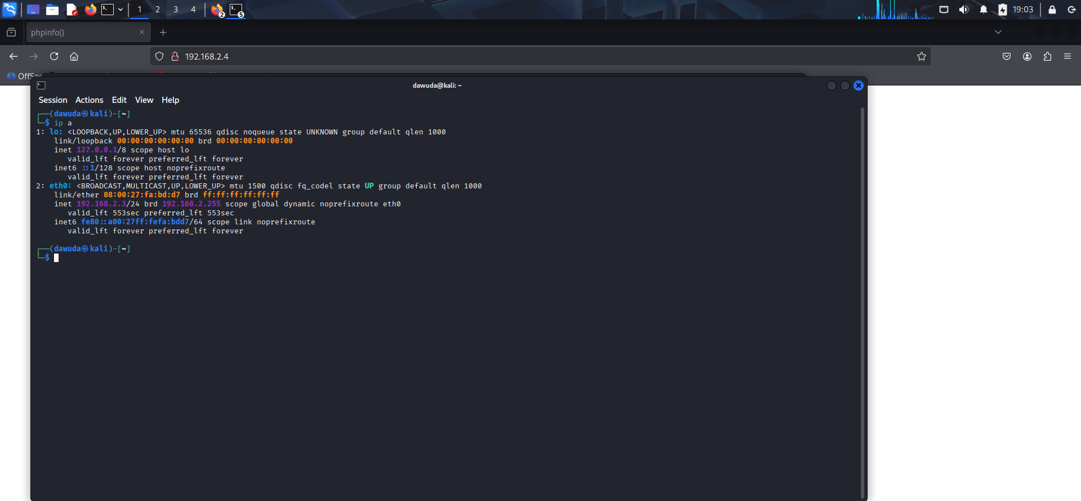
Host ip address

Slide 8
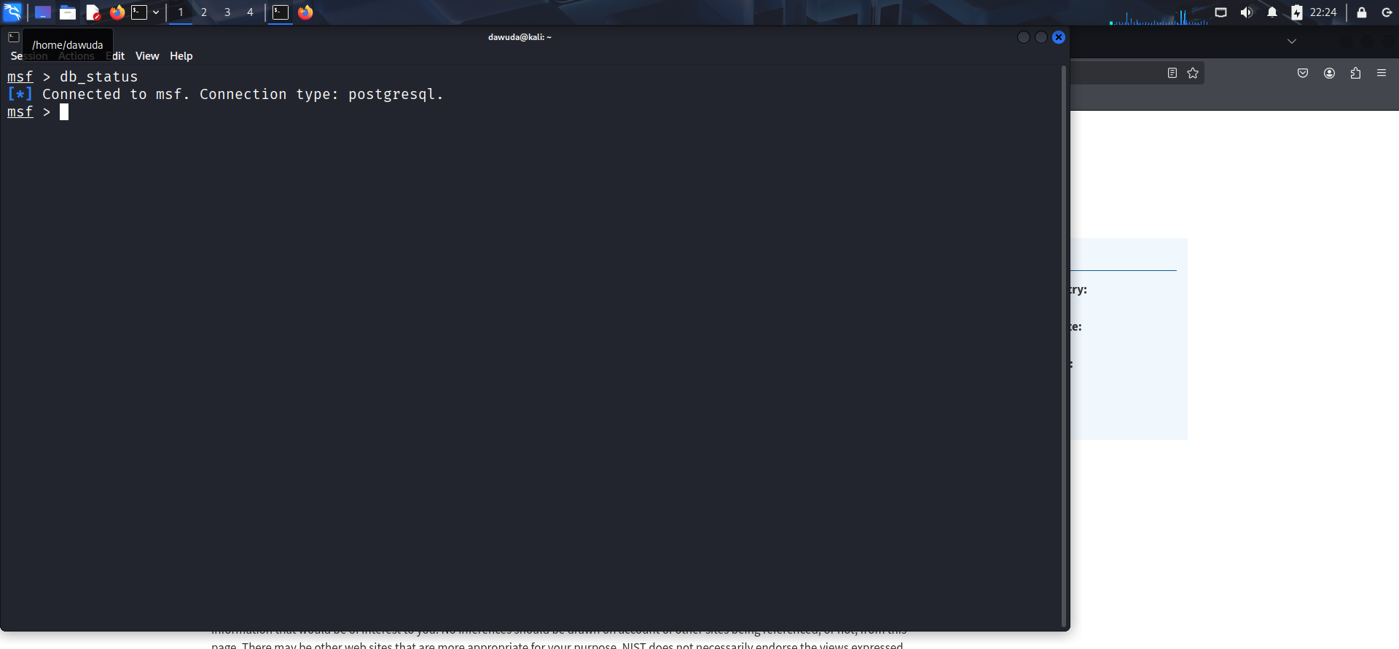
Set-up database for the engagement

Slide 9
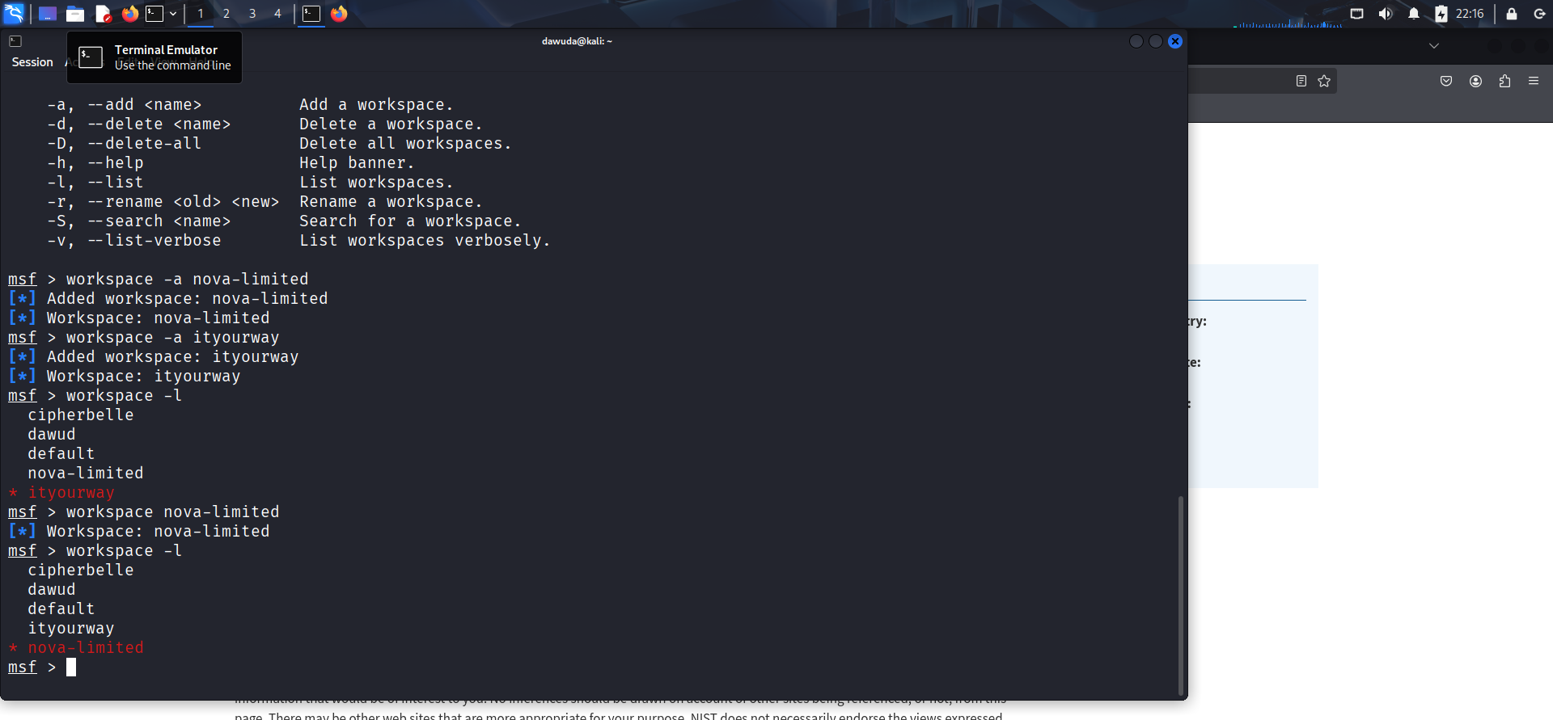
Nova Penetration workspace

Slide 10
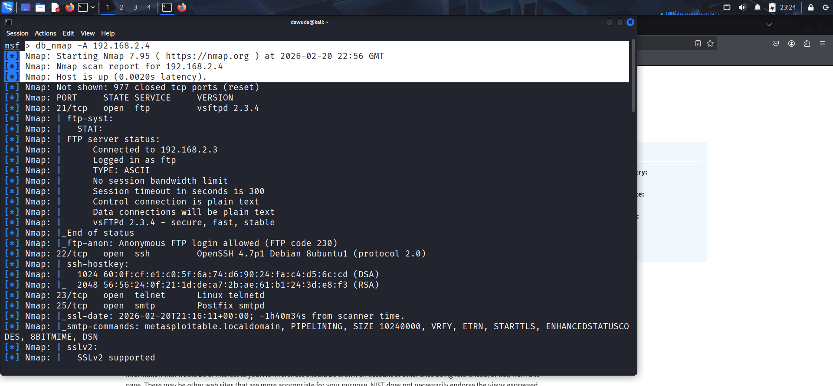
Reconnaissance-Nmap scan discovery

Slide 11
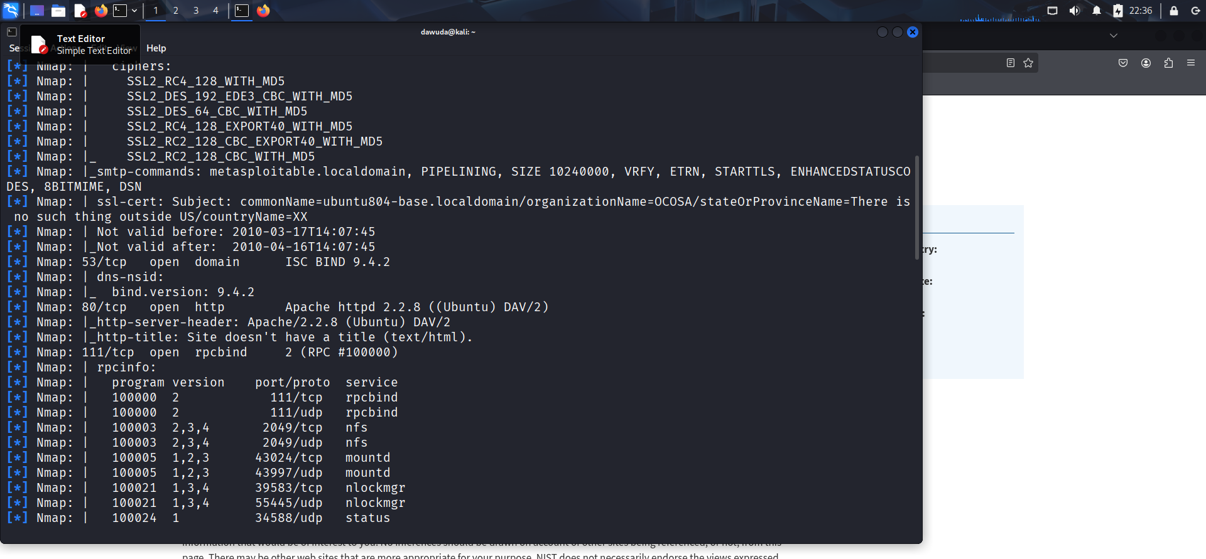
Apache http 2.2.8 Nmap scan 1

Slide 12
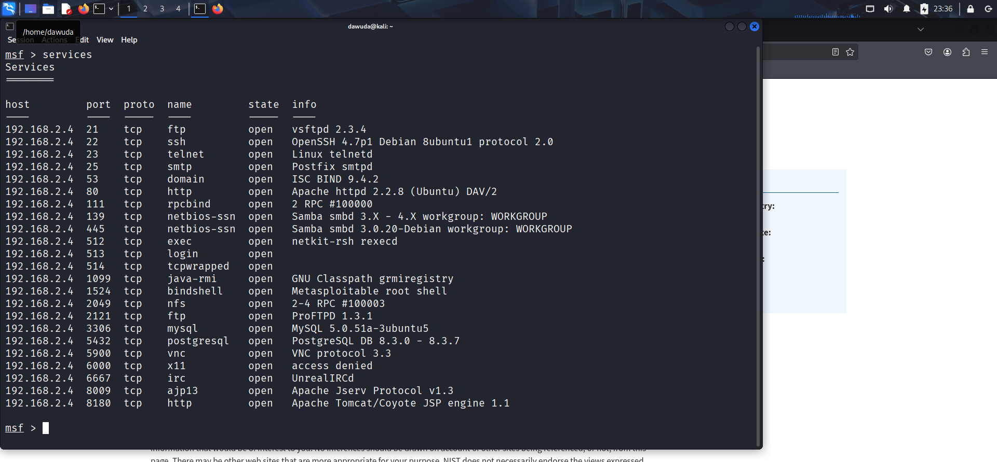
Nmap scan - open port and services

Slide 13
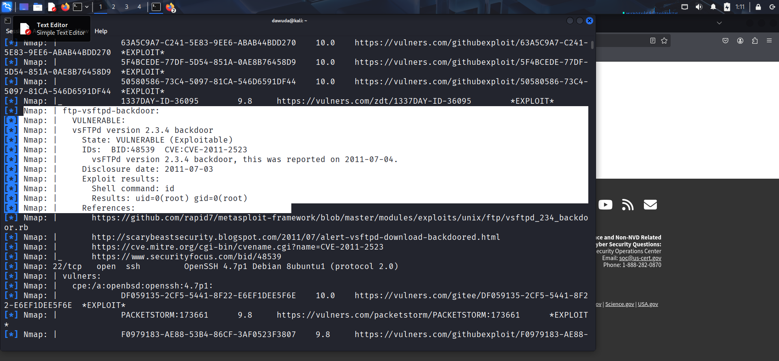
Enumeration of services- vsftpd

Slide 14
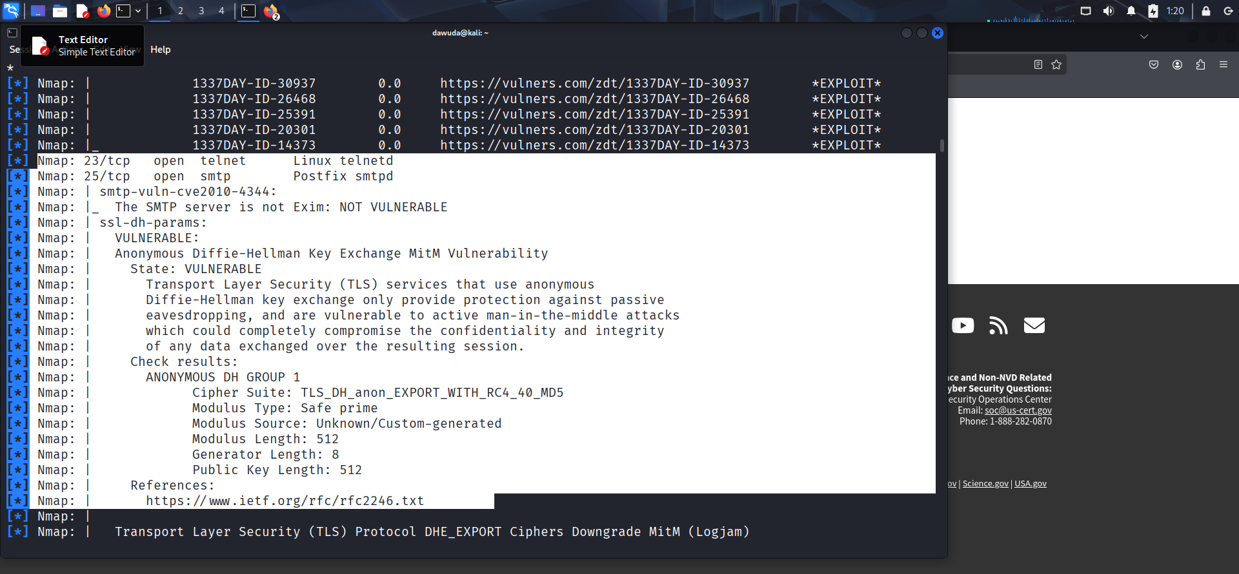
Telnet

Slide 15
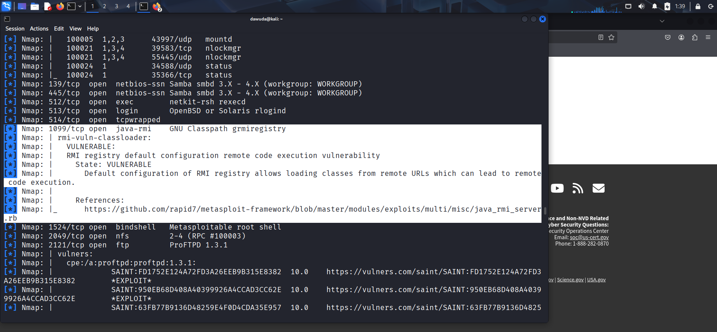
Java rmi

Slide 16
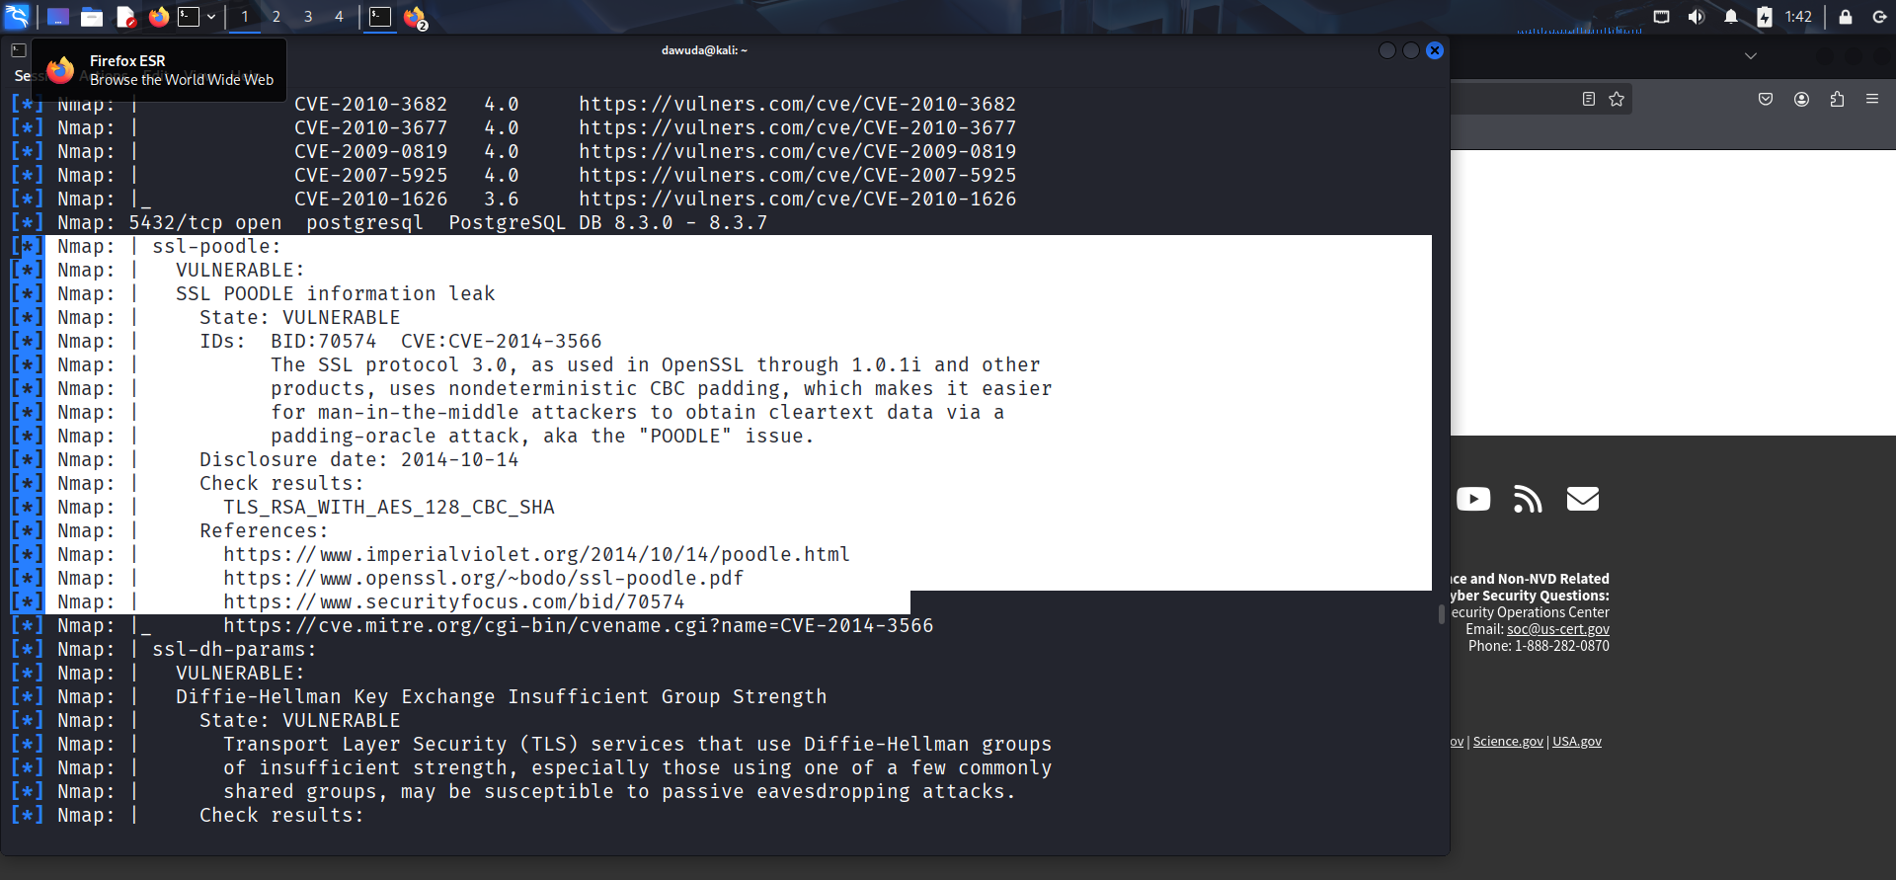
ssl-poodle

Slide 17
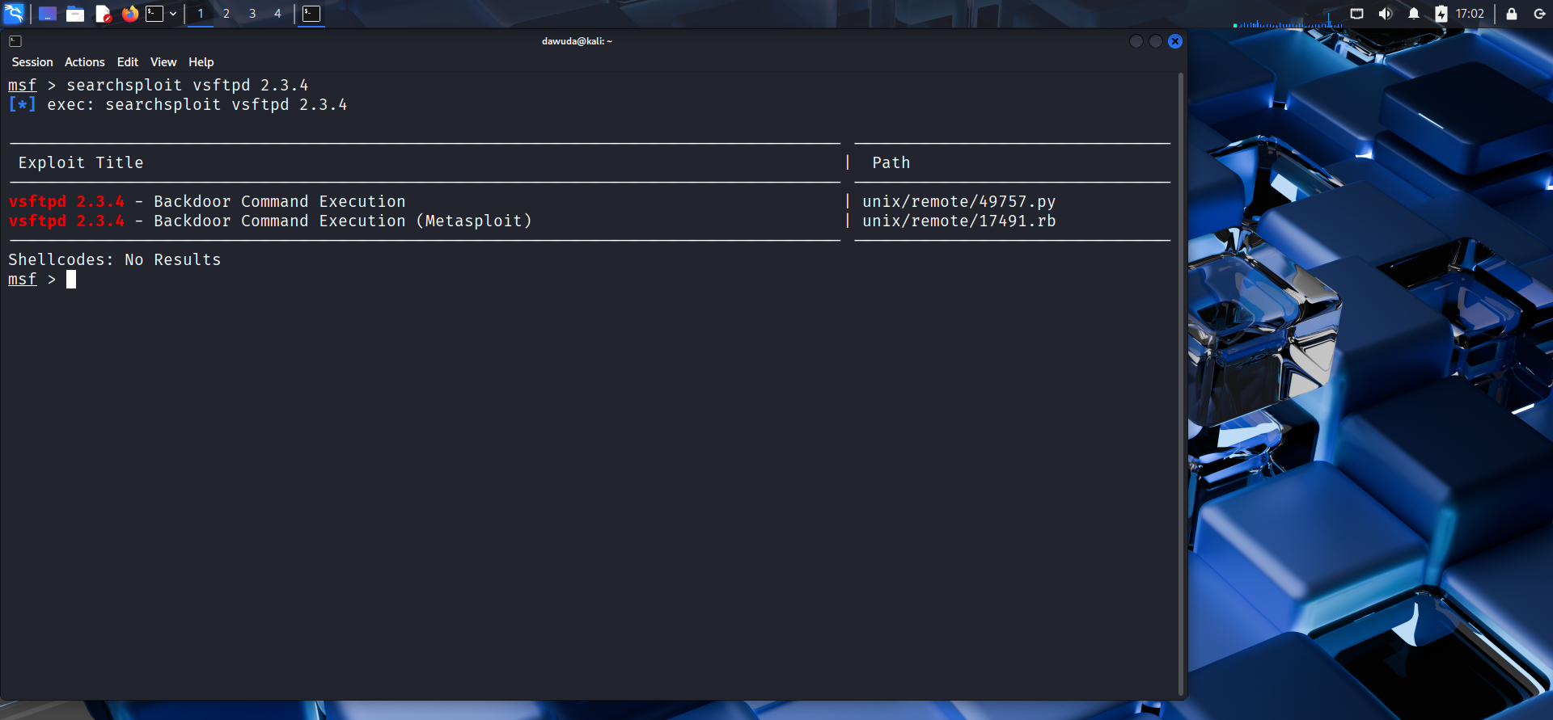
Vulnerability Scanning – Exploit on vsftpd

Slide 18
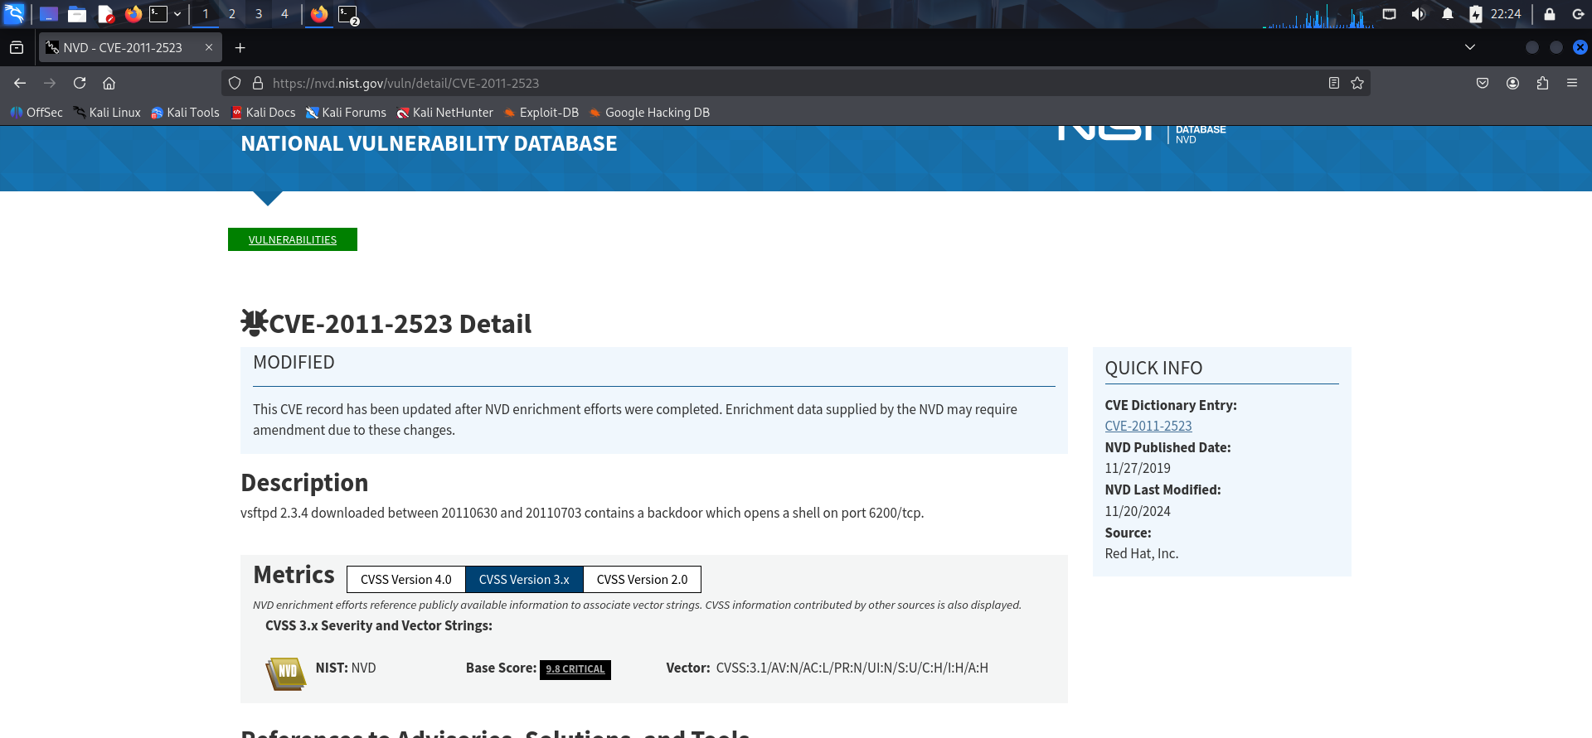
CVE - vsftpd

Slide 19
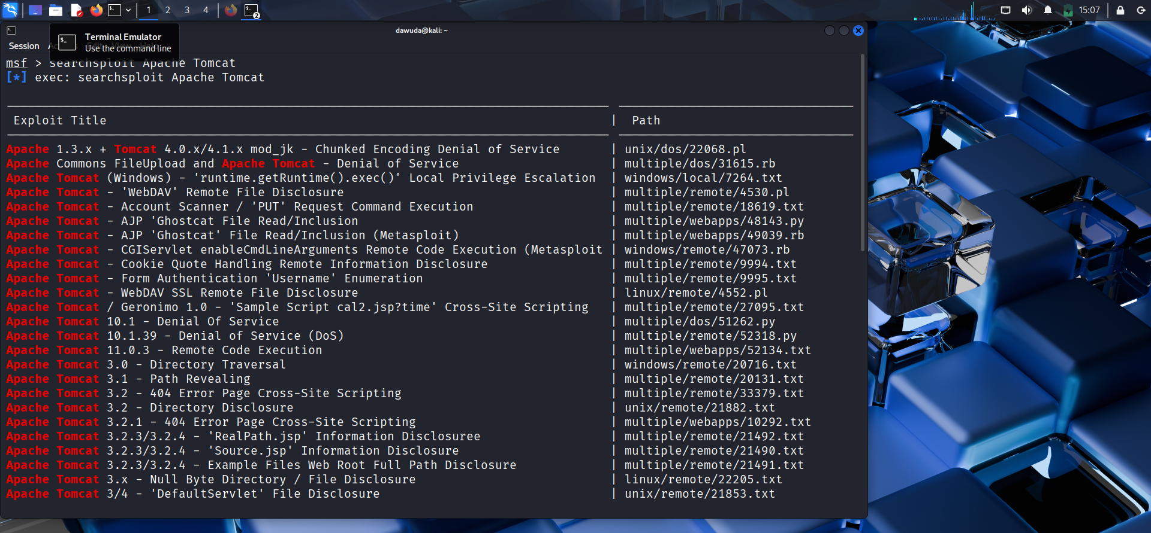
Exploit on Apache tomcat

Slide 20
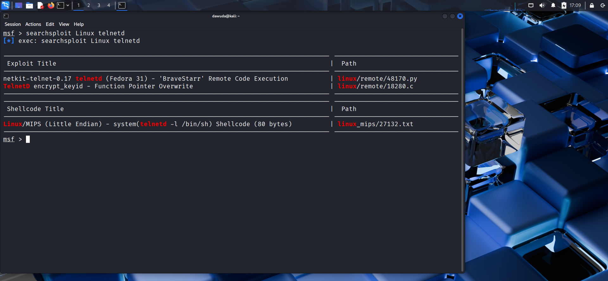
Exploit on Telnet

Slide 21
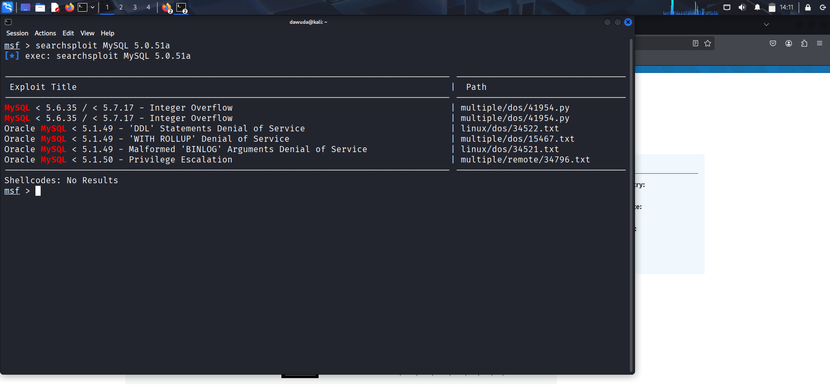
Exploit on MySQL

Slide 22
Vulnerability Analysis & Prioritisation
Severity is ranked according to CVSS v2/v3 Base Scores provided by the National Vulnerability Database (NVD).
Rank | Port | Services / Version | CVE ID | Severity | Impact
1 | 8180 | Apache tomcat | CVE-2010-2784 | 10.0 (Crit) | Deploy malicious application Server takeover
2 | 21 | vsftpd 2.3.4 | CVE-2011-2523 | 10.0 (Crit) | Backdoor: Unauthorized remote shell access.
3 | 1099 | Java RMI RCE | CVE-2011-3556 | 10.0 (Crit) | Allows unauthenticated remote class loading.
4 | 23 | Linux telnet | CVE-2026-24061 | 9.8 (Crit) | Root Shell: Env variable injection
5 | 22 | OpenSSH 4.7p1 | CVE-2023-38408 | 9.8 (Crit) | Remote Code Execution
6 | 80 | Apache 2.2.8 | CVE-2008-0455 | 7.5 (High) | System Compromise
7 | 2049 | NFS | CVE-1999-0554 | 7.5 (High) | File System Access: Unrestricted mounting
8 | 5432 | PostgreSQL | CVE-2012-0868 | 6.8 (Med) | SQL Injection
9 | 5432 | Logjam | CVE-2015-4000 | 5.9 (Med) | Session decryption (512-bit keys).
10 | 3306 | MySQL | CVE-2008-4097 | 4.6 (Med) | Bypass privilege checks for data directory.

Slide 23
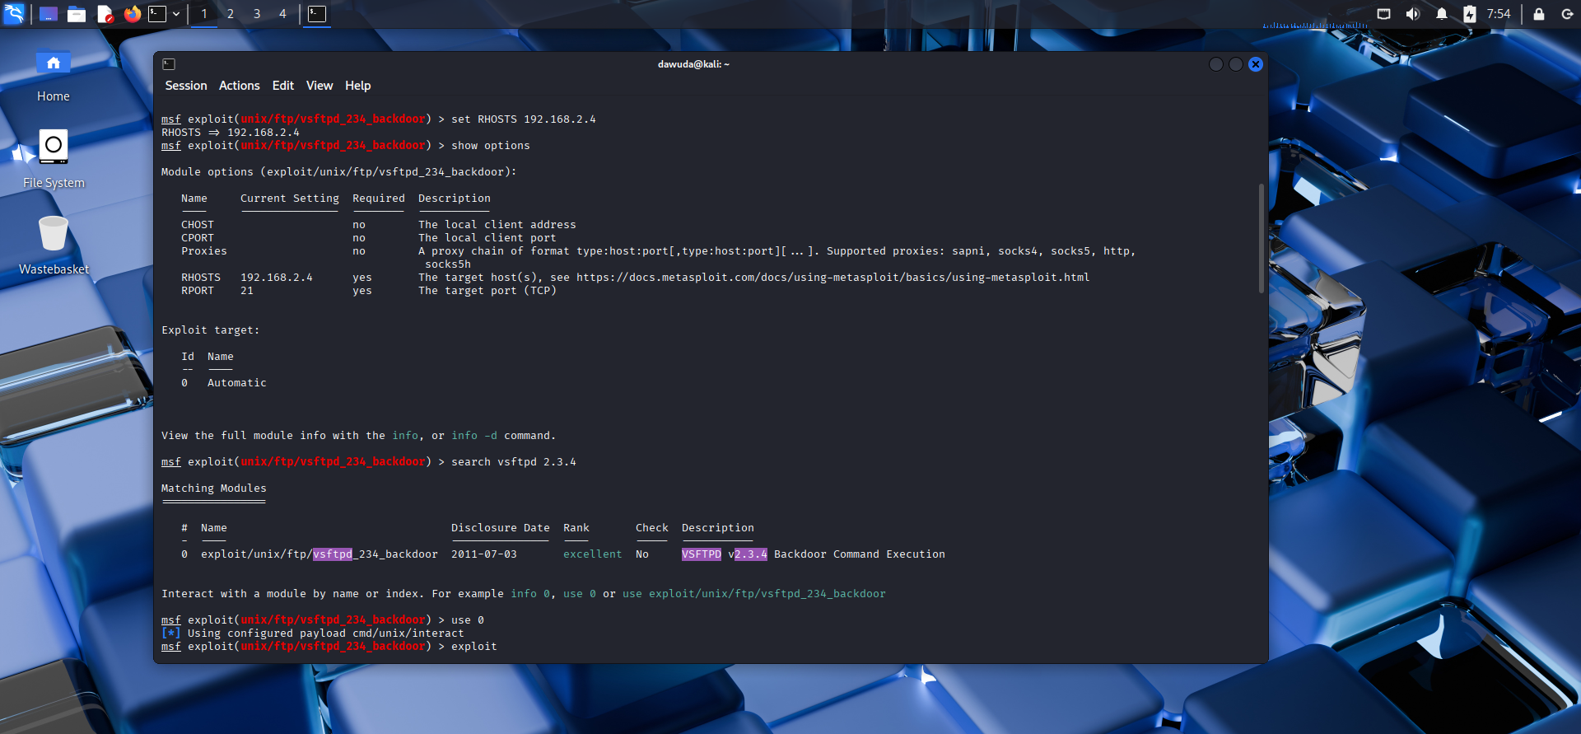
Exploitation of service - vsftpd 2.3.4

Slide 24
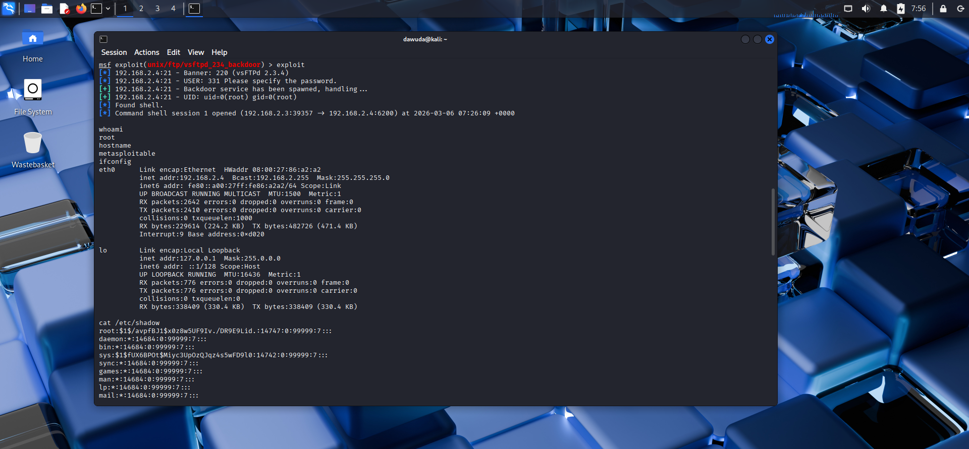
vsftpd 2.3.4

Slide 25
Post-Exploitation of vsftpd 2.3.4

Slide 26
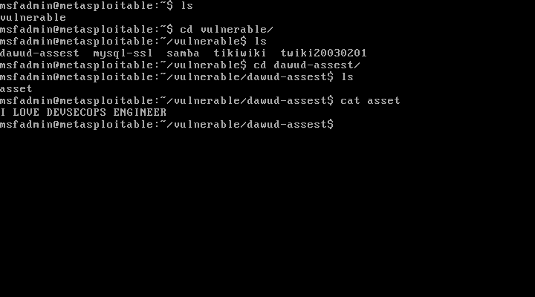

Slide 27
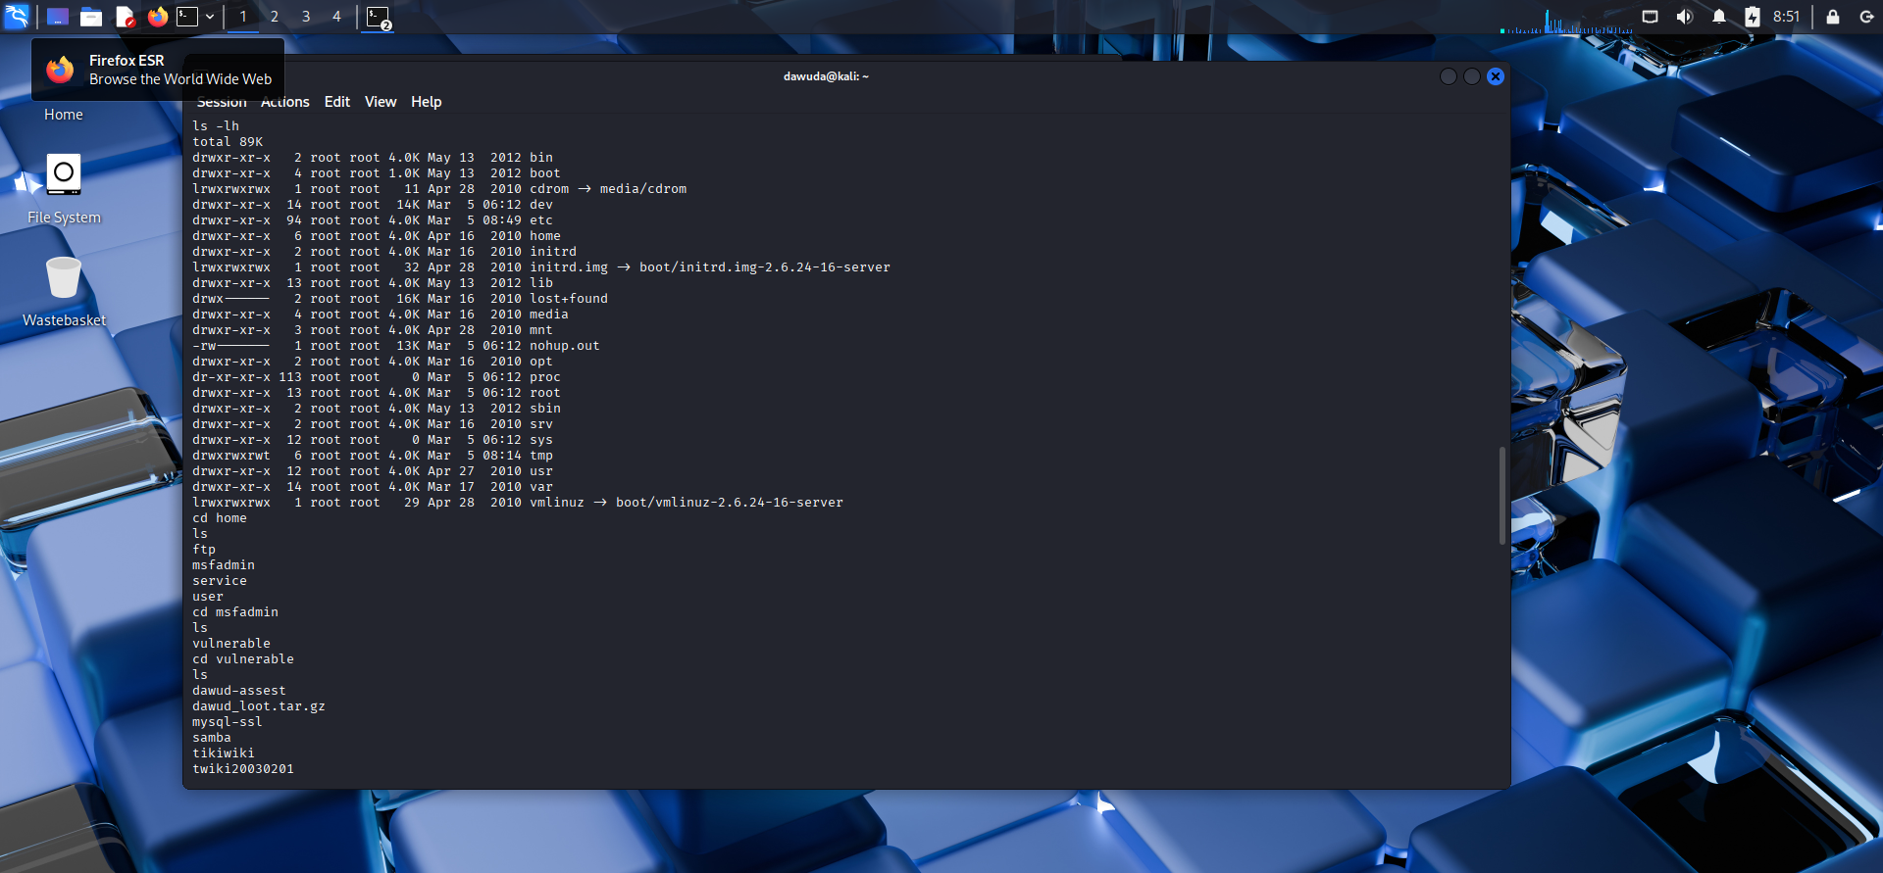

Slide 28


Slide 29
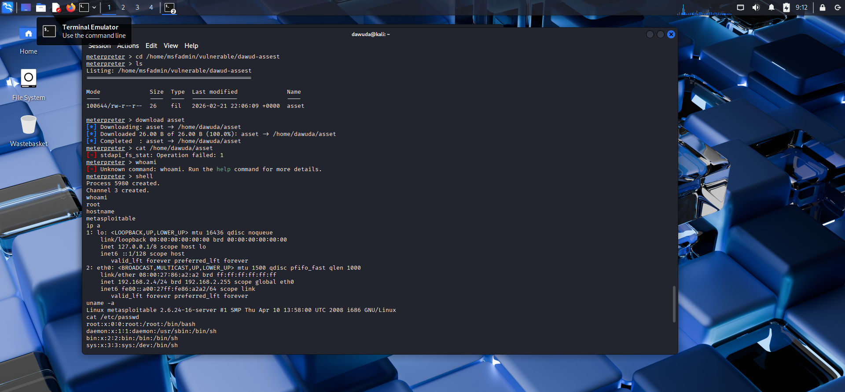

Slide 30


Slide 31


Slide 32
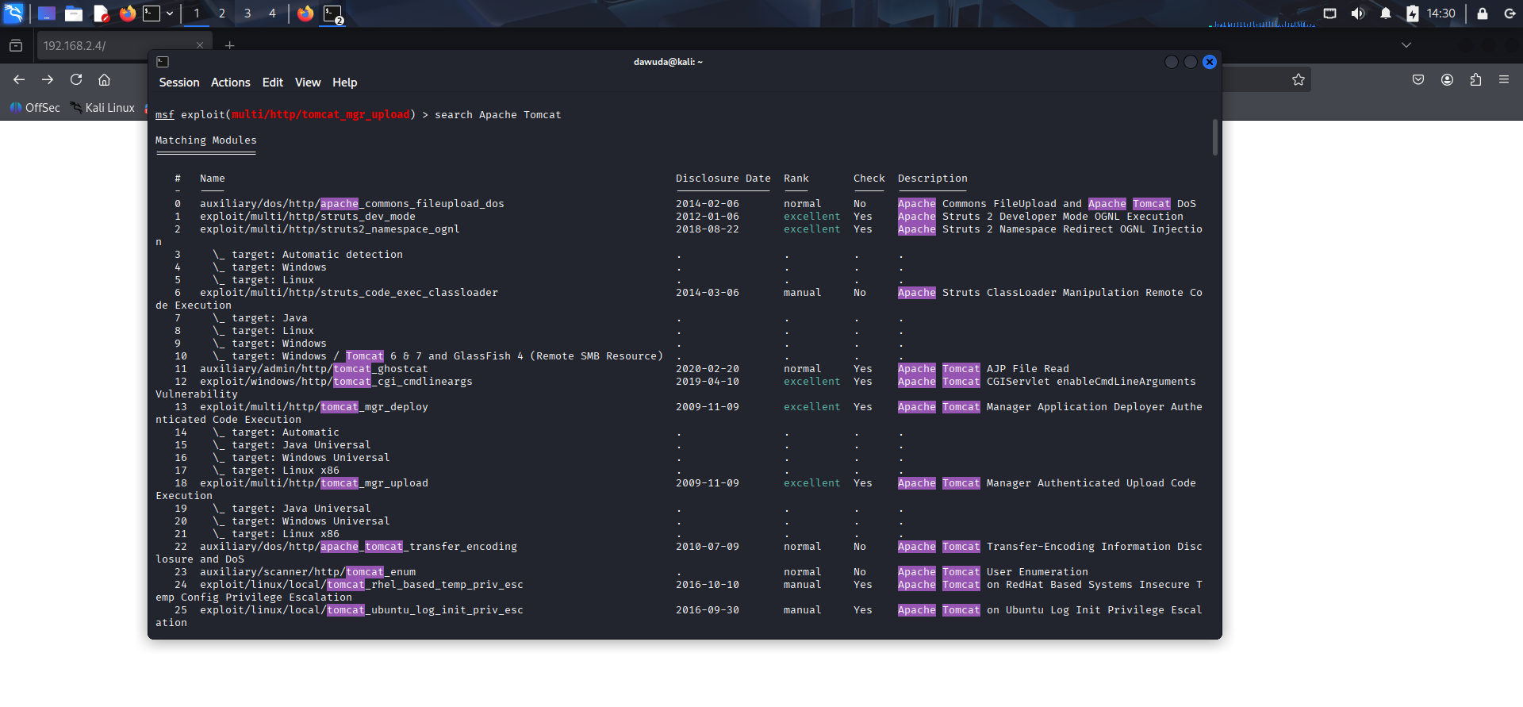
Exploitation of service – Apache Tomcat

Slide 33
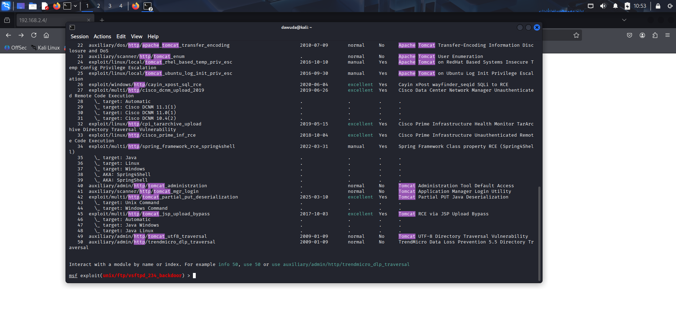

Slide 34
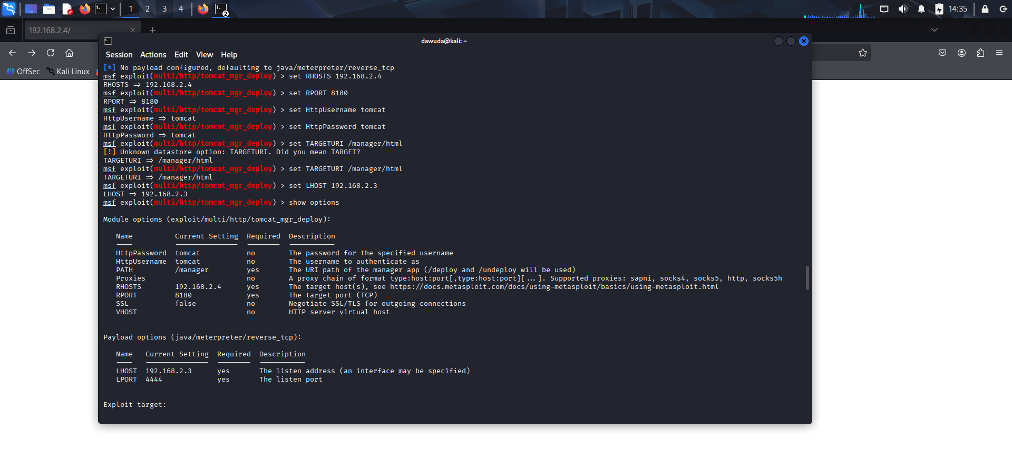

Slide 35
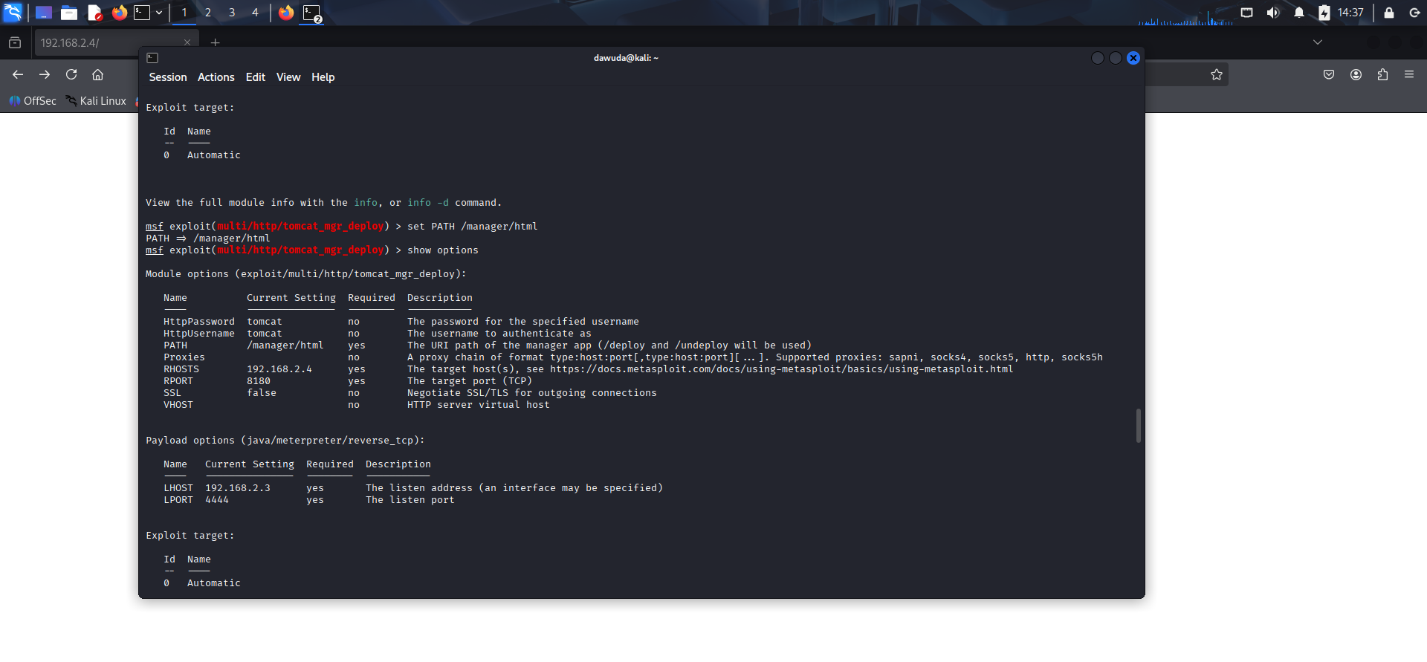

Slide 36
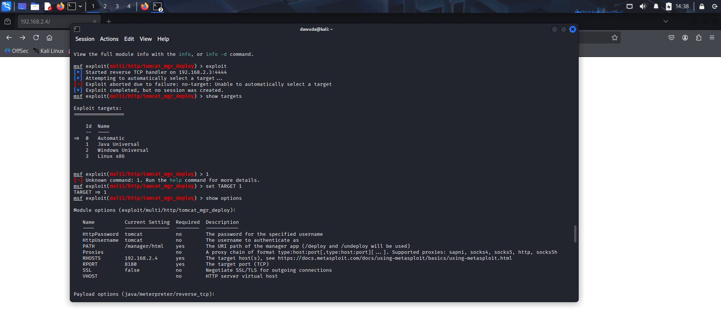

Slide 37
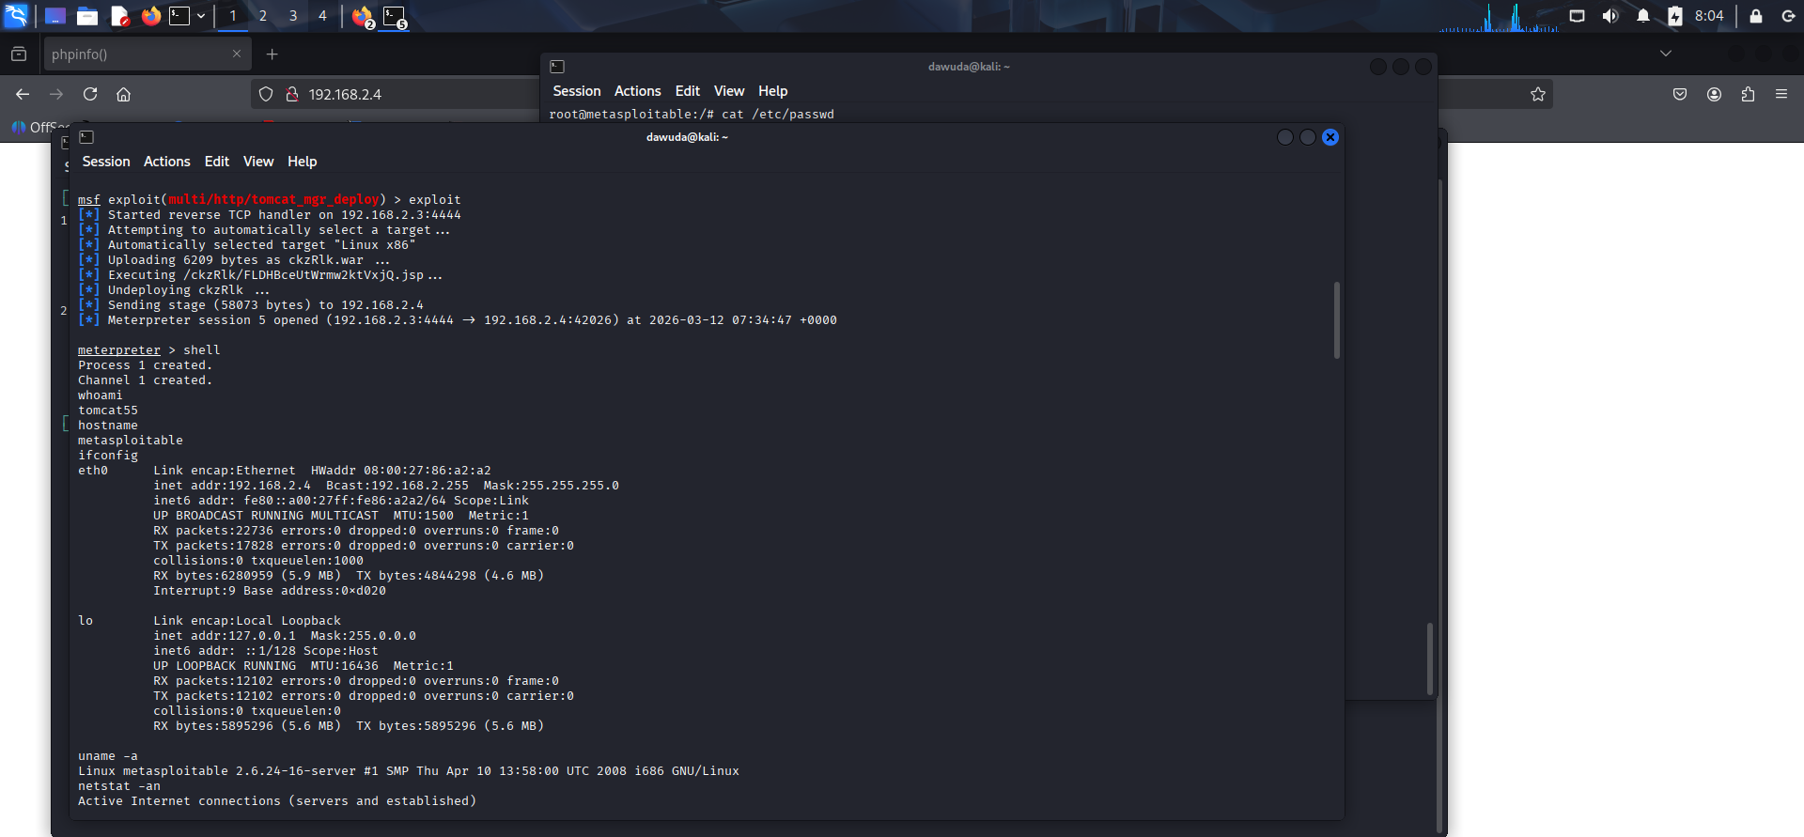

Slide 38
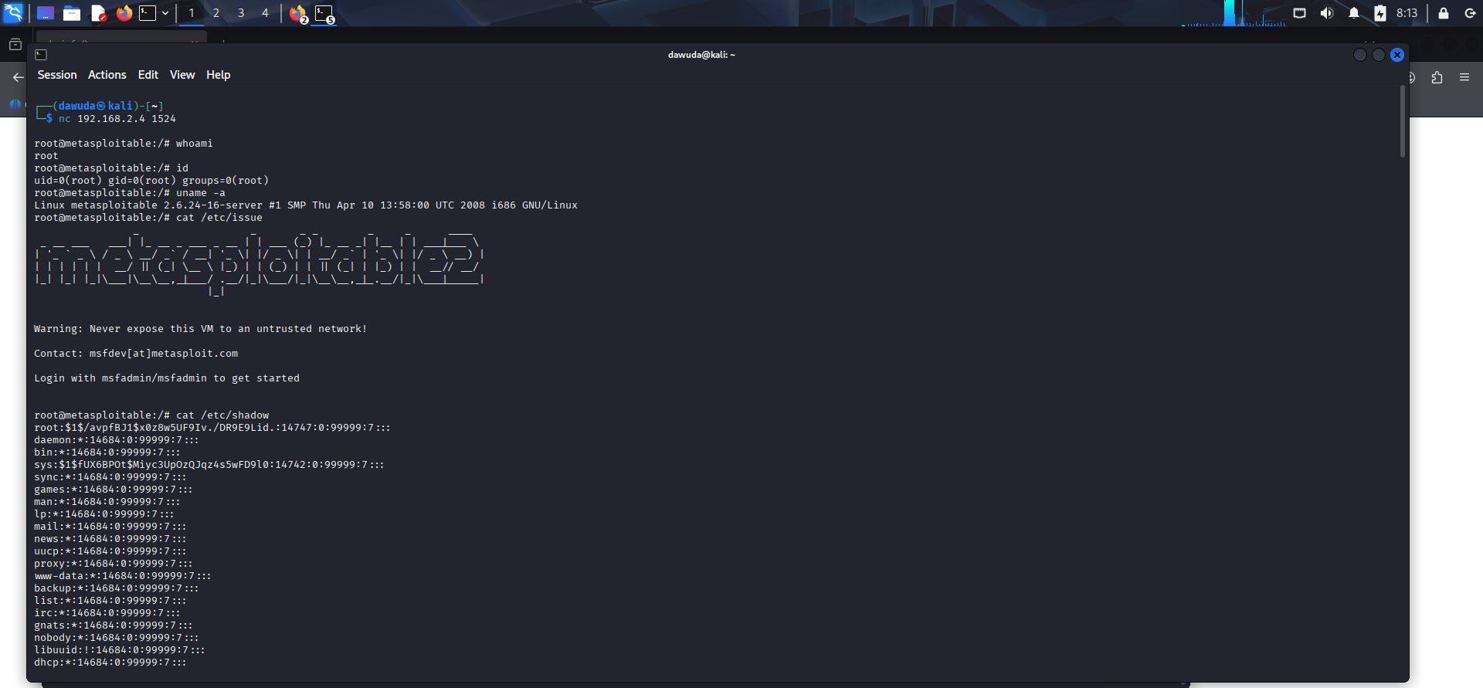
Post exploitation of service – Apache Tomcat

Slide 39
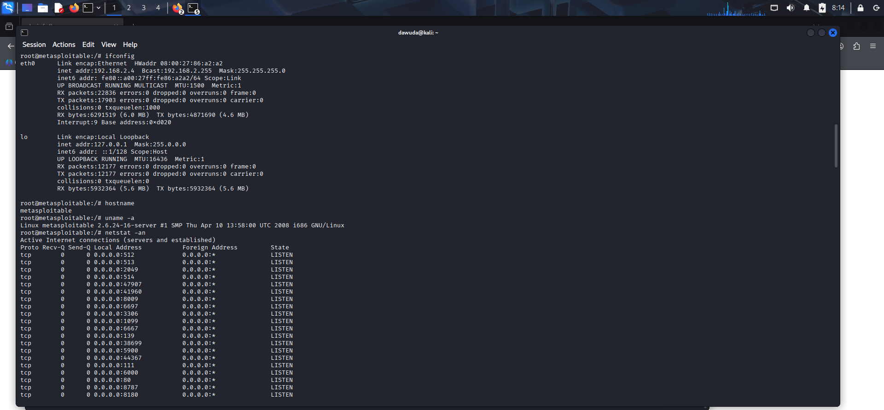

Slide 40
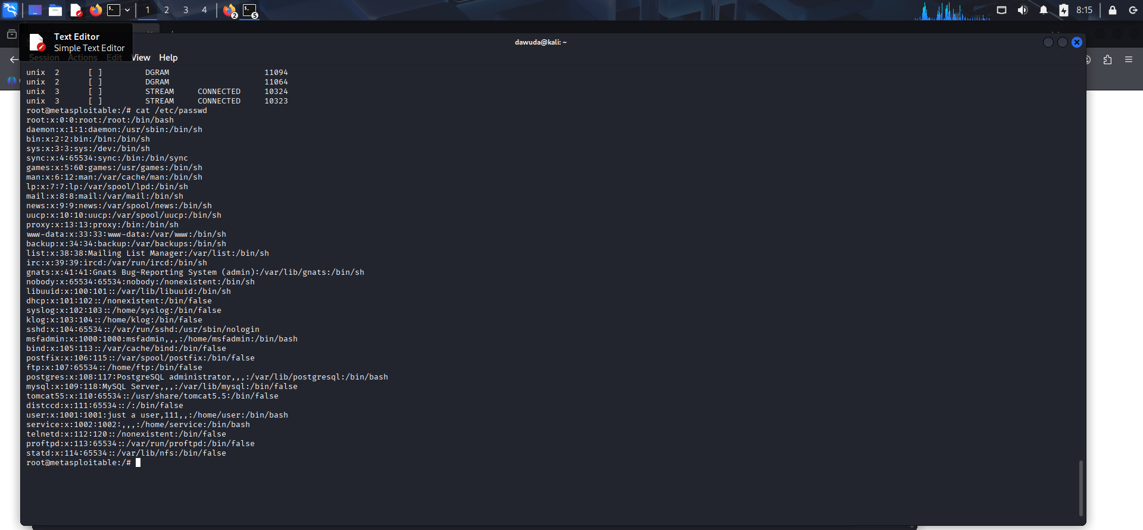

Slide 41
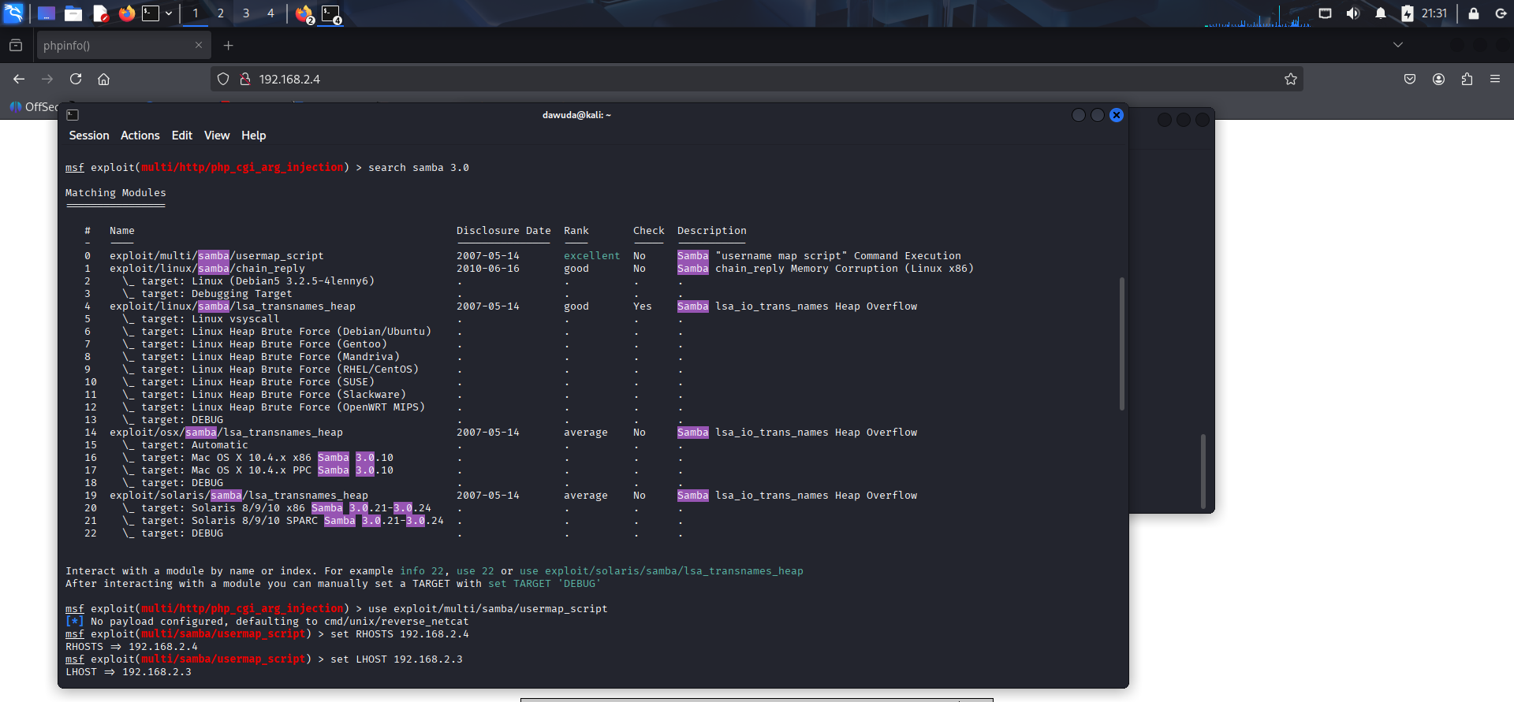
Exploitation of service – Samba(SMB)

Slide 42
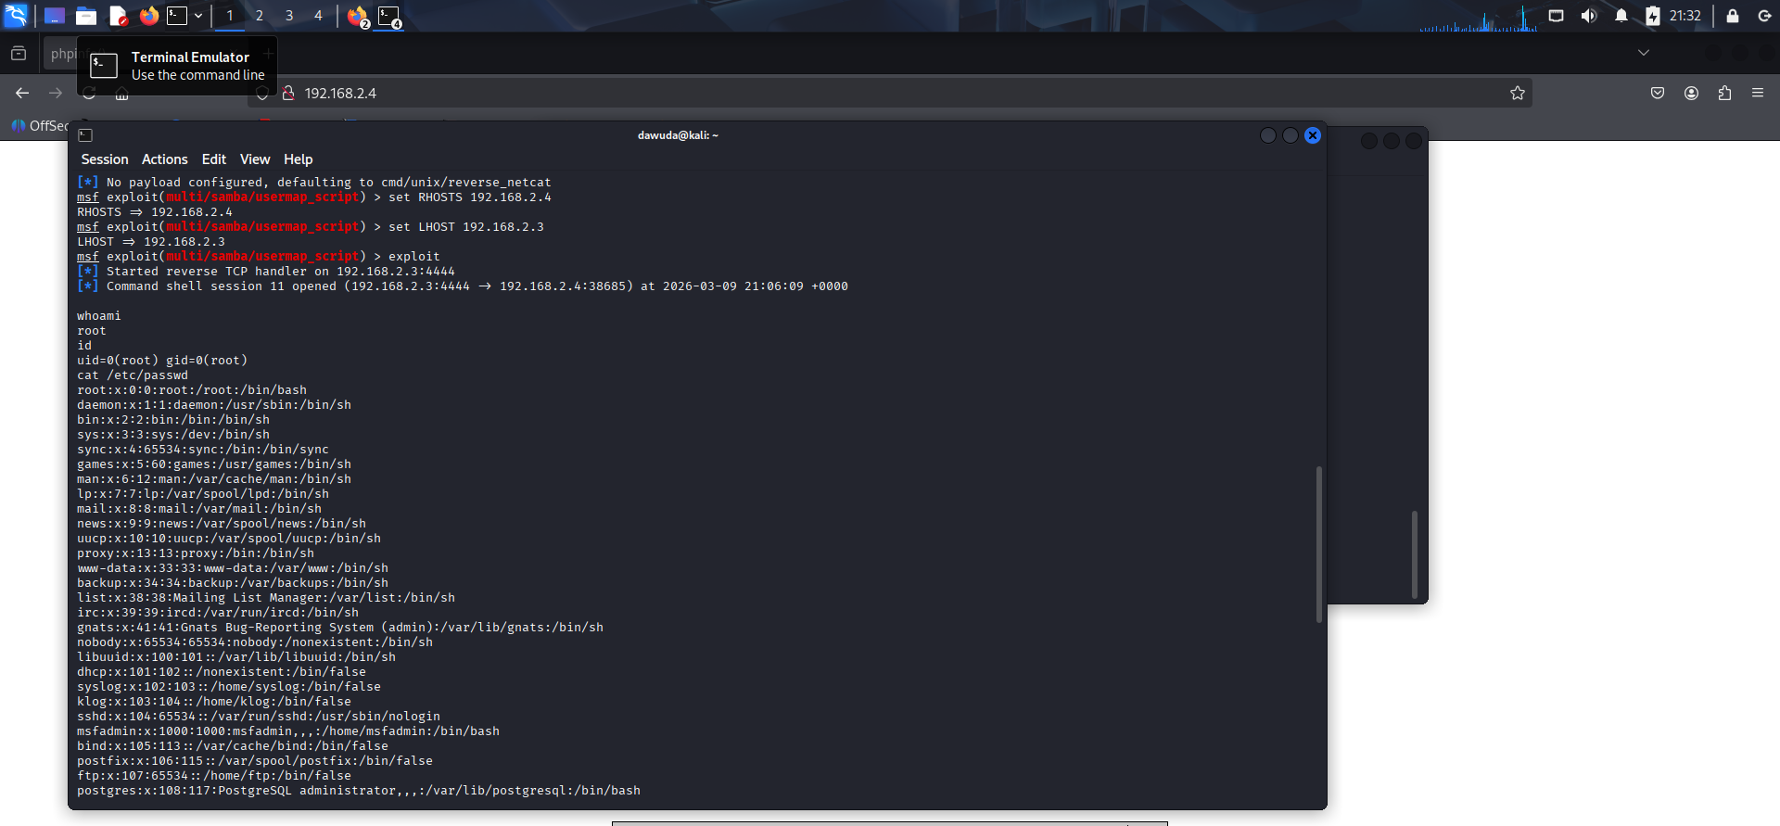

Slide 43
Post-Exploitation of Samba (SMB)

Slide 44
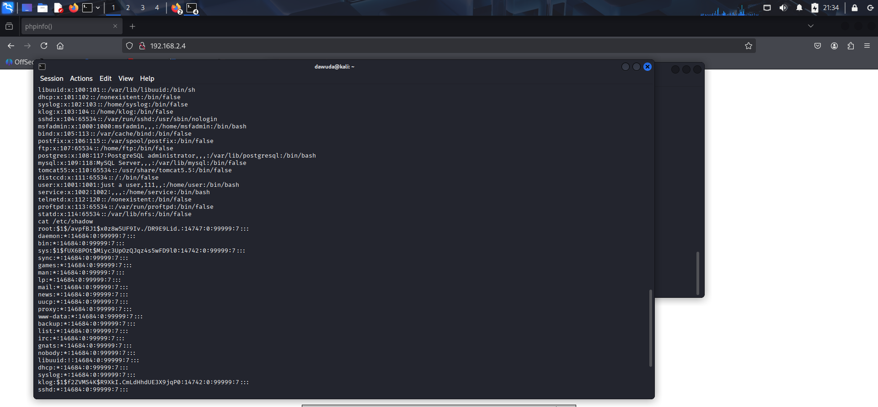

Slide 45
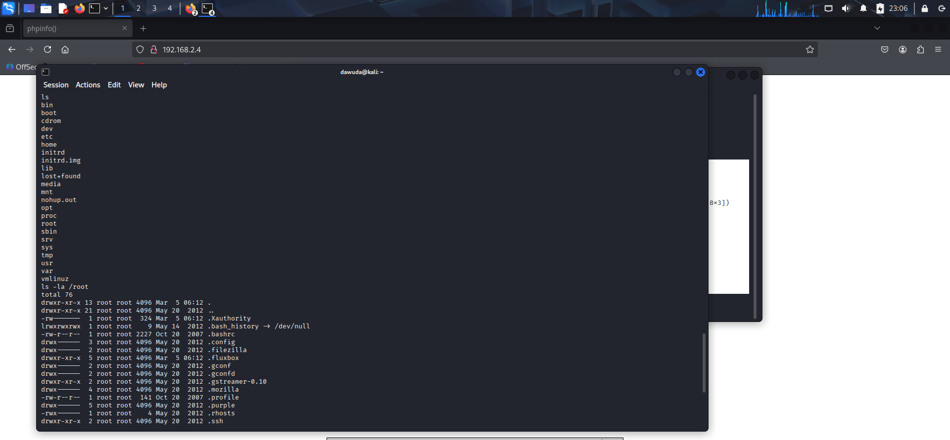

Slide 46
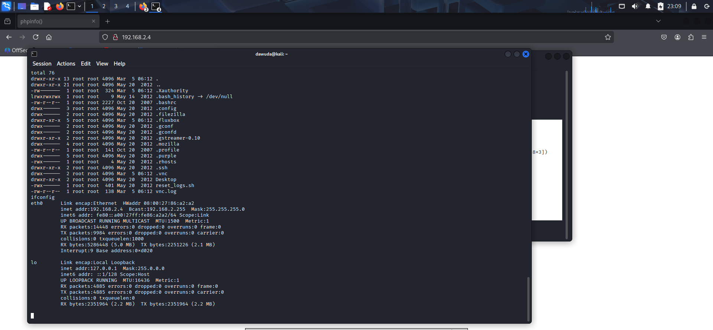

Slide 47
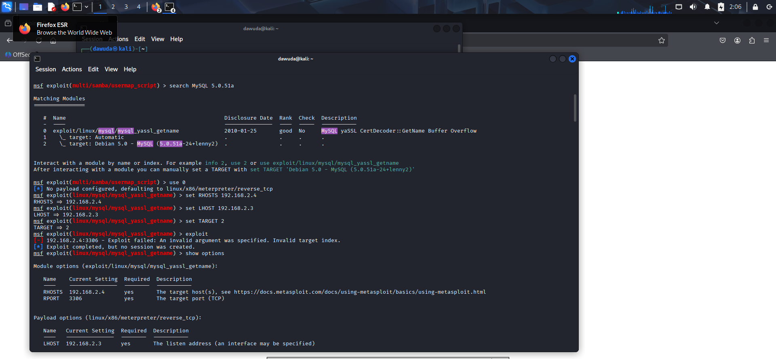
Exploitation of service – MySQL

Slide 48
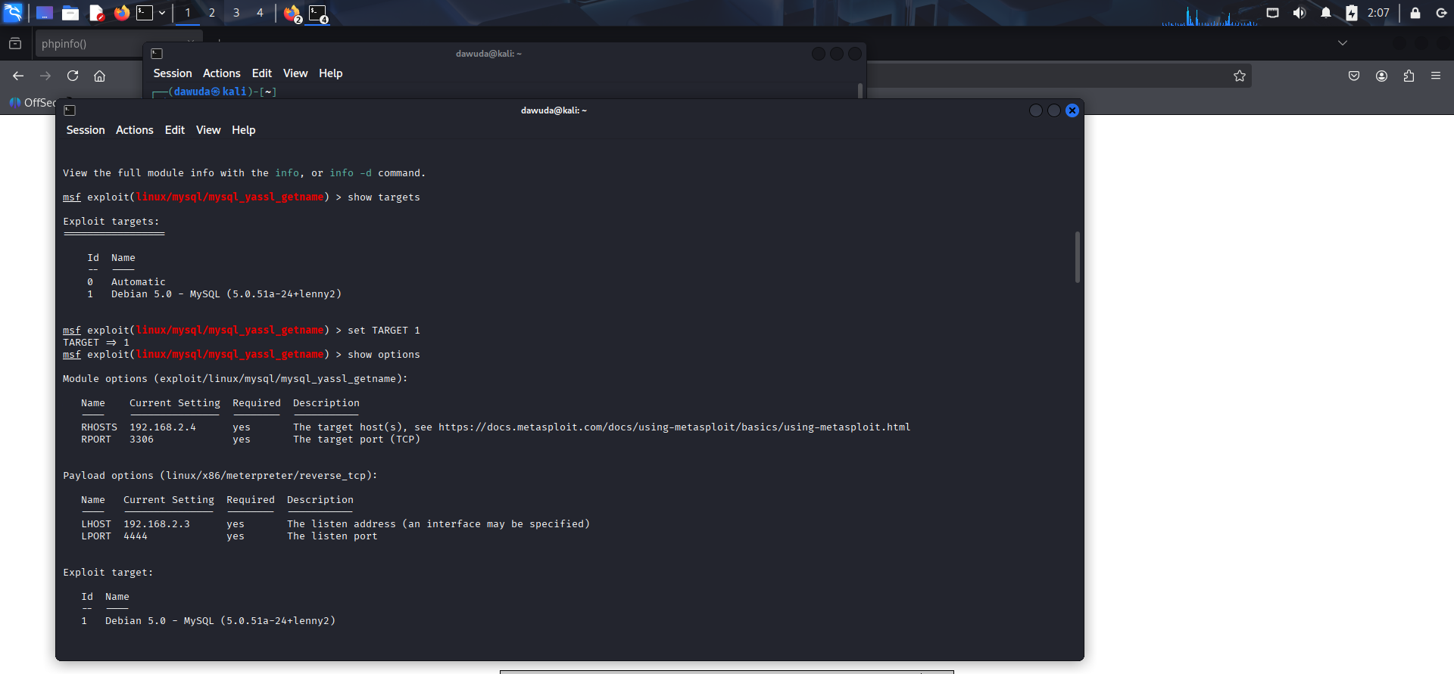

Slide 49
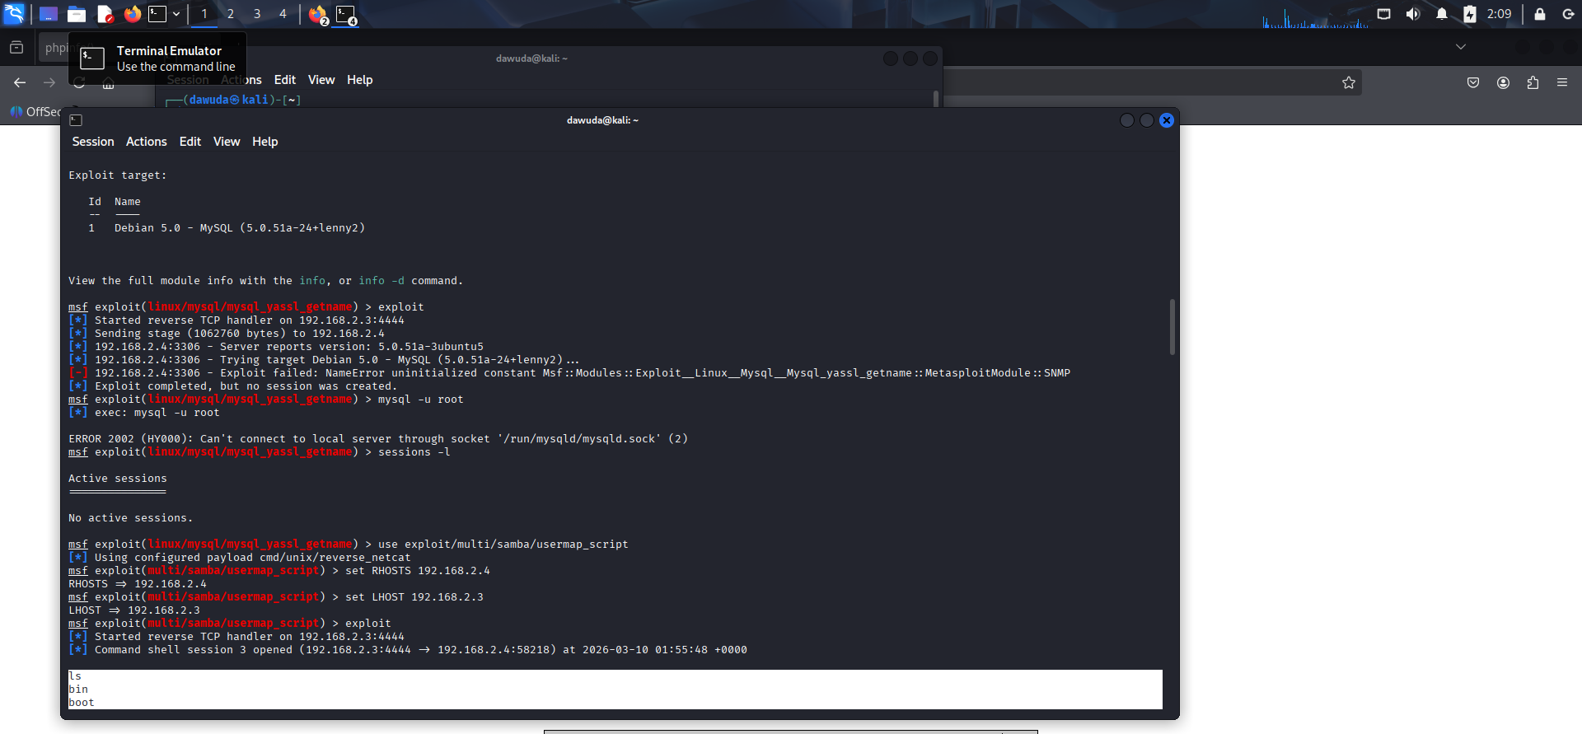

Slide 50
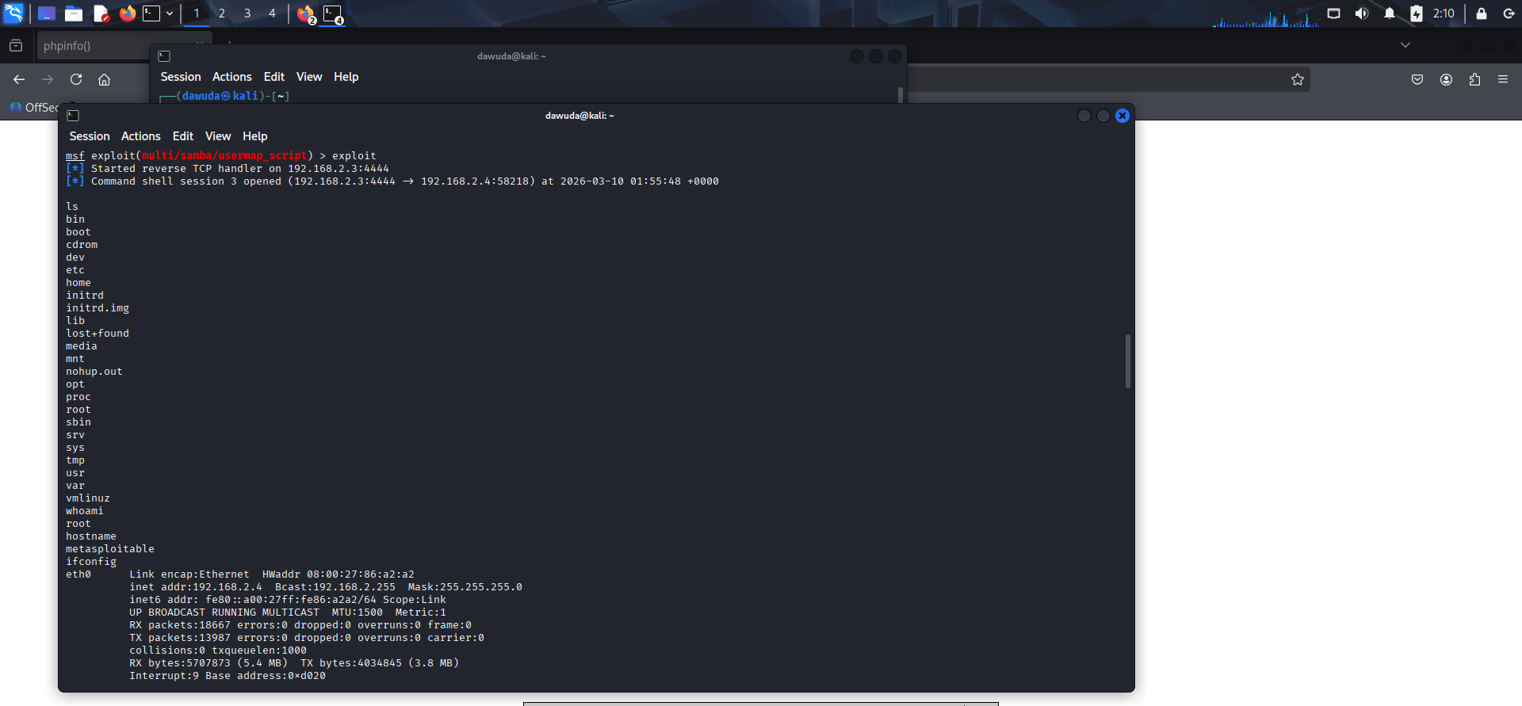

Slide 51
Post-Exploitation of MySQL

Slide 52
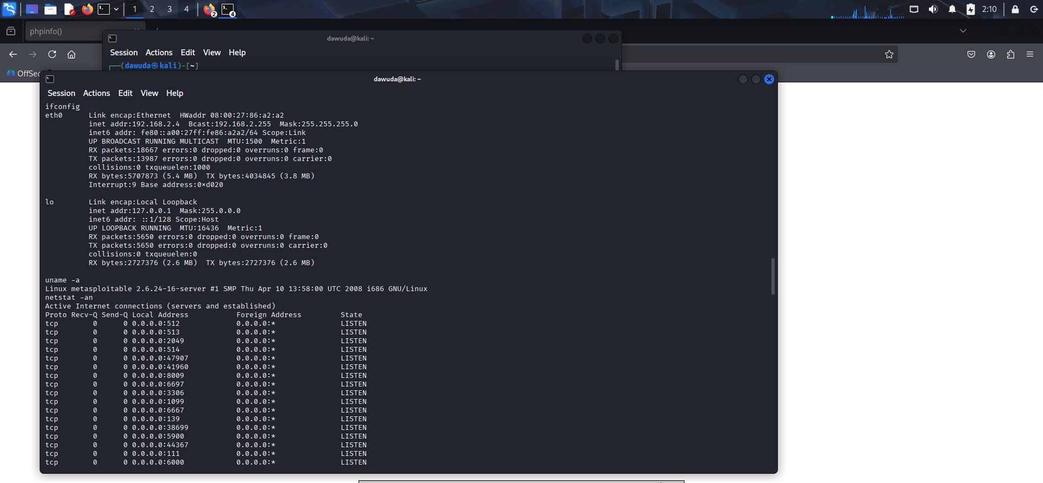

Slide 53
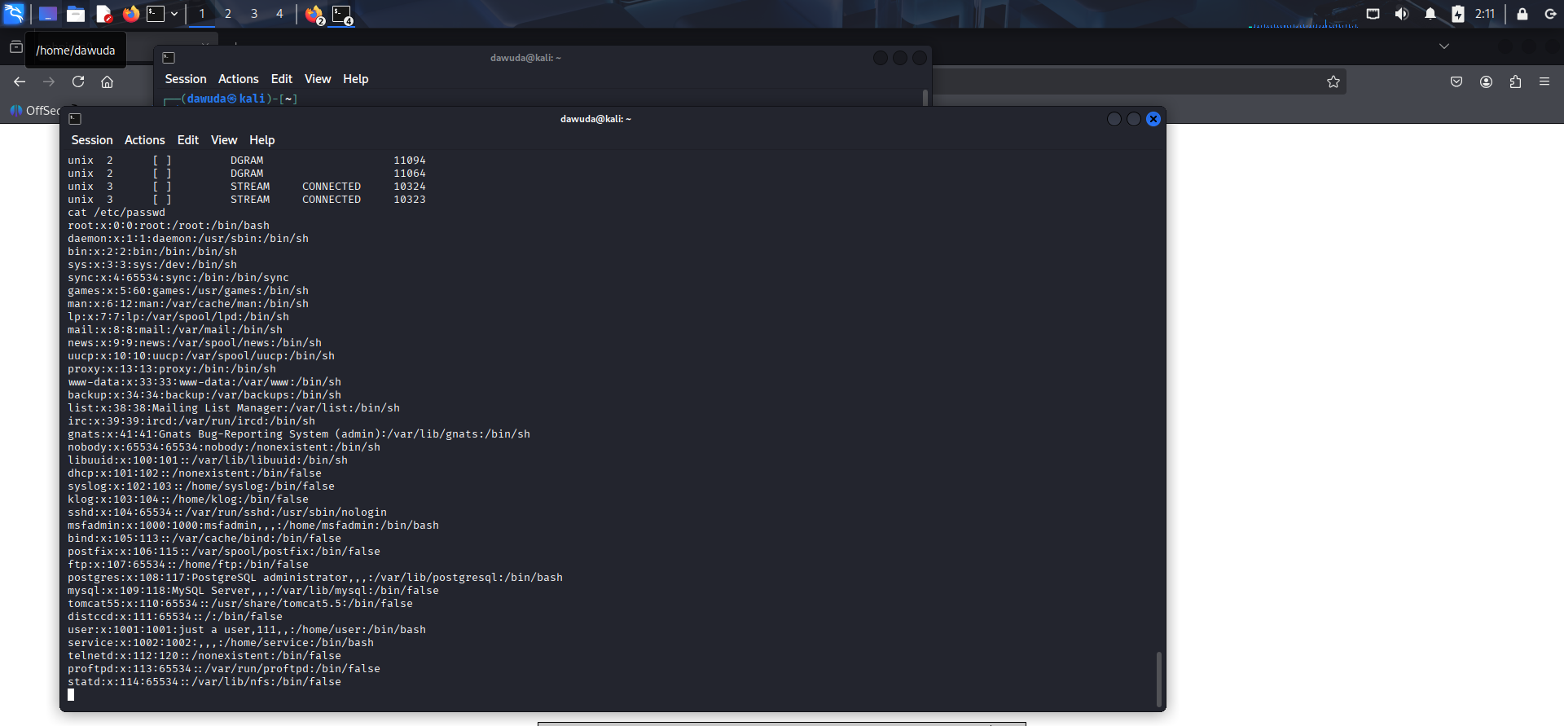

Slide 54
Impact of Vulnerabilities
Business
The vulnerabilities identified present significant risks to business operations, data security, and organisational reputation. If exploited in a production environment, these weaknesses could allow attackers to gain full control of the system and access sensitive information.
Data Breach Risk
Attackers gaining root-level access could access confidential data stored on the system, including databases, user credentials, and internal documents. This could lead to data leakage, regulatory violations, and loss of customer trust.
Operational Disruption
Compromised systems could be used to disrupt business services. Attackers may shut down servers, delete critical files, or alter system configurations, resulting in downtime and loss of productivity.

Slide 55
Financial Loss
Security incidents often lead to financial costs related to Incident response and investigation, system recovery and restoration, legal penalties for data protection violations and potential compensation for affected customers.
Reputational Damage
A successful cyberattack can significantly damage an organisation's reputation. Customers and partners may lose confidence in the organisation's ability to protect sensitive information.
Lateral Movement Within the Network
Once attackers obtain root access, they may use the compromised system as a pivot point to attack other systems within the internal network. This could result in a broader compromise of the organisation's infrastructure.
Malware Deployment
Attackers could install malicious software such as ransomware, spyware, or backdoors. This may allow continued unauthorized access or enable attackers to demand payment to restore systems.

Slide 56
Recommendations
To improve the security posture of the system, the following actions are recommended:
1. Remove Backdoors. Immediately disable the root bindshell on port 1524
2. Update Vulnerable Software such as vsftpd, Samba, Apache Tomcat, MySQL
3. Disable Insecure Services. Telnet should be replaced with secure alternatives like SSH.
4. Implement Network Segmentation.
5. Strong Authentication of strong password sand multi-factor authentication
6. Deploy intrusion detection/prevention systems (IDS/IPS) to catch abnormal activities.
7. Awareness and Training about social engineering, phishing, and safe security practices.
8. Conduct regular vulnerability scanning and penetration tests to detect new risks.

Slide 57
Conclusion
The penetration test revealed that the target system is highly vulnerable to compromise due to outdated software, exposed services, and insecure configurations. Immediate remediation is recommended to address these vulnerabilities, including updating software, securing exposed services, and hardening system configurations to reduce the risk of exploitation.

Slide 58

THANK YOU

